Slide 1
Debunking The Top 6 Myths about Employee Engagement and Advocacy
Lessons from the frontline at Carnival Cruise Line
MARCH 30, 2017

Slide 2
Our Speakers
Lemar Ingram
Digital Engagement Manager
Carnival Cruise Line
@LemarIngram
Greg Shove
Founder & CEO
SocialChorus
@GregShove
Notes:
twitter handles?

Slide 3
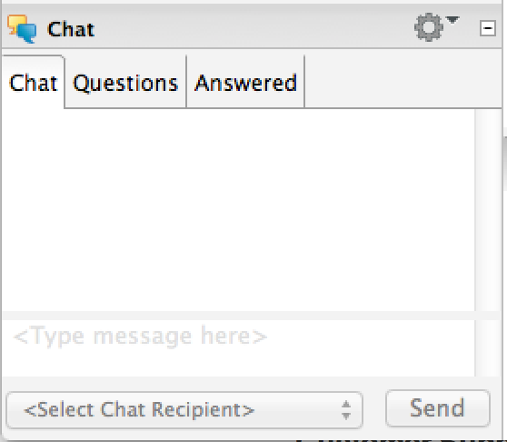
Have a Question?
Chat with us on ReadyTalk!

Slide 4
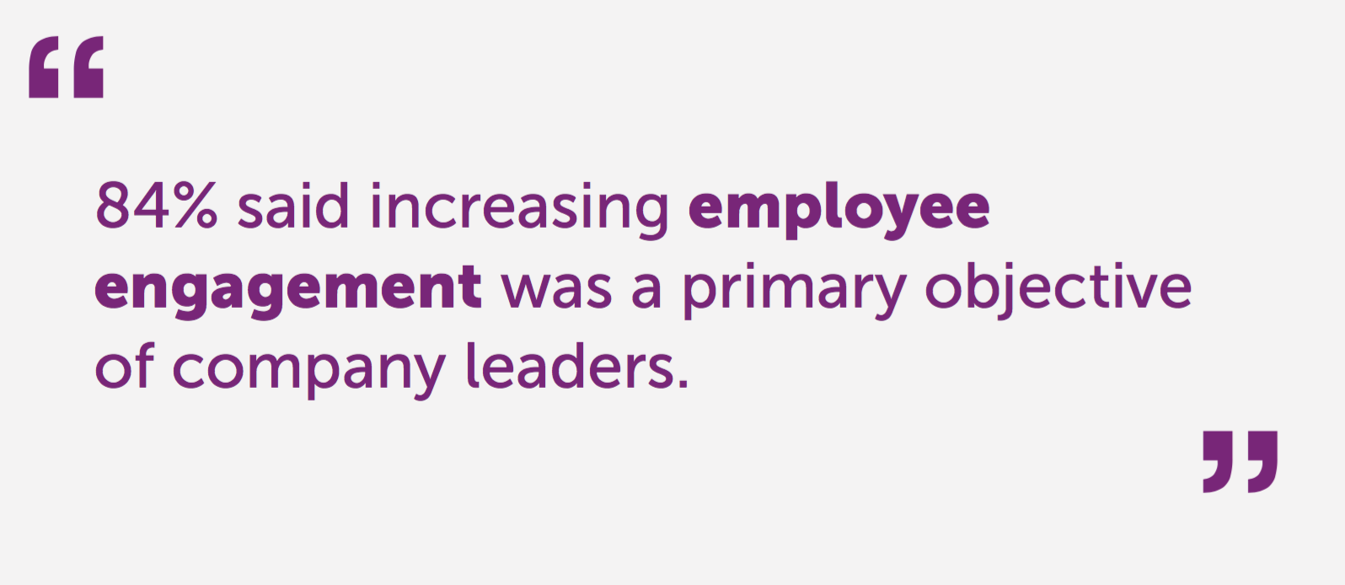
2016 Survey of more than 300 HR and Communications Professionals

Slide 5
Carnival Cruise Line
43,000 employees between shipboard and shoreside
Carnival carries ~4.5 million passengers annually
Outbound sales, inbound sales, service teams
Across South Florida in multiple buildings
Communication challenges
Too many emails that didn’t apply
Rapidly changing environment - weather and incidents
Notes:
add photos

Slide 6
Employee Engagement Philosophy
The same way you generate customer engagement
Great consistent content
Different content formats
Benefit
Sales and service employees have the right info at right time
Driving revenue through employee advocacy

Slide 7
Social Selling - Opportunities for Employees
Increase employee & customer advocacy
Social selling will streamline and quantify both employee and customer advocacy efforts
Advocacy efforts will be brand compliant to aid with brand salience/recognition
Increase customer engagement
& retention
Active participation via personal networks allow for higher engagement
Engaged customers are likely to remain brand loyal
7
Notes:
Biggest benefits

Slide 8
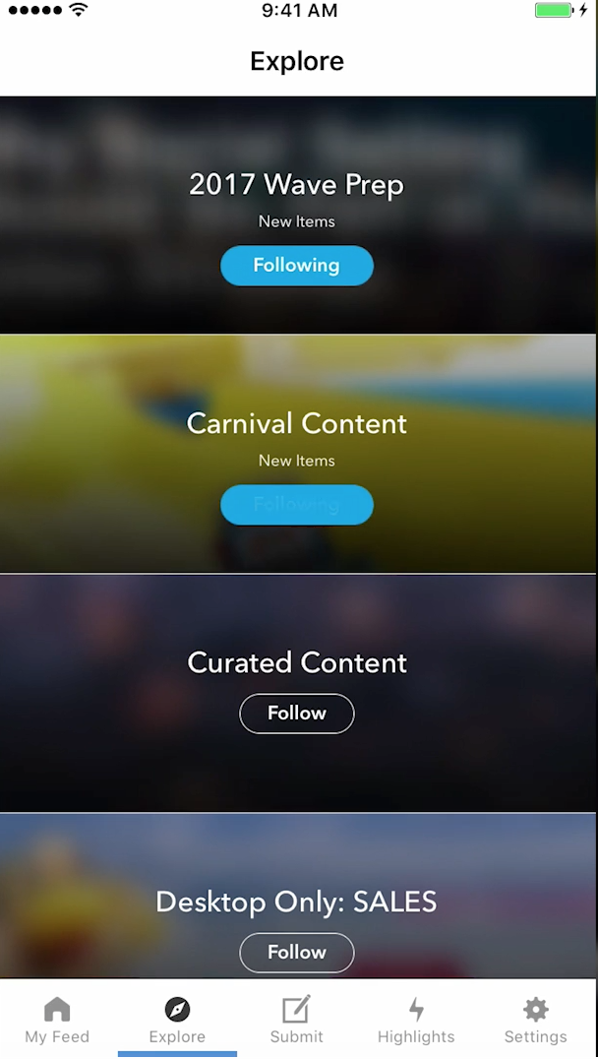
First Mate
V1
Advocacy focused
V2
Ensure internal service and inbound teams were up to date with information
Brand awareness
Employee communications

Slide 9
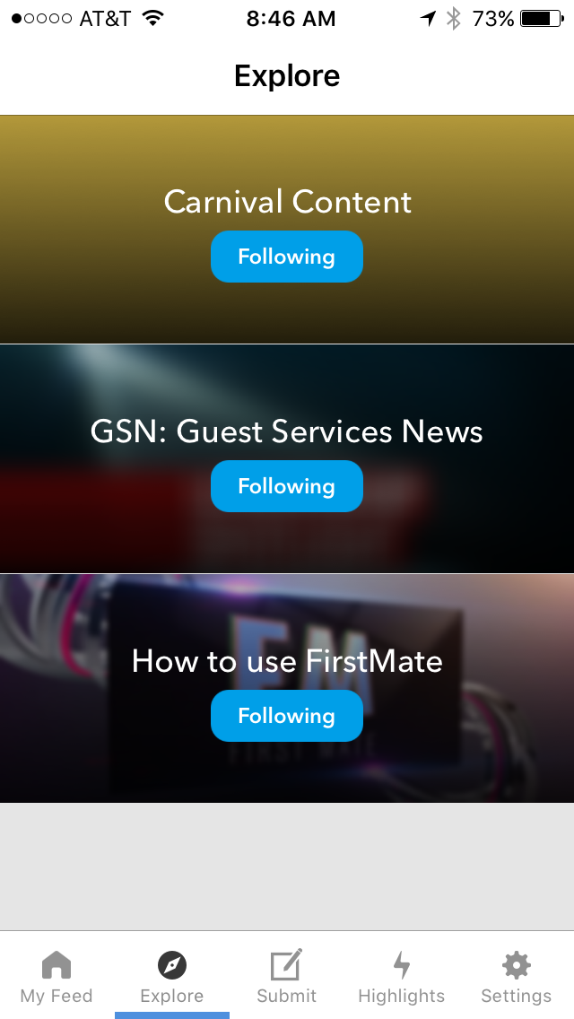
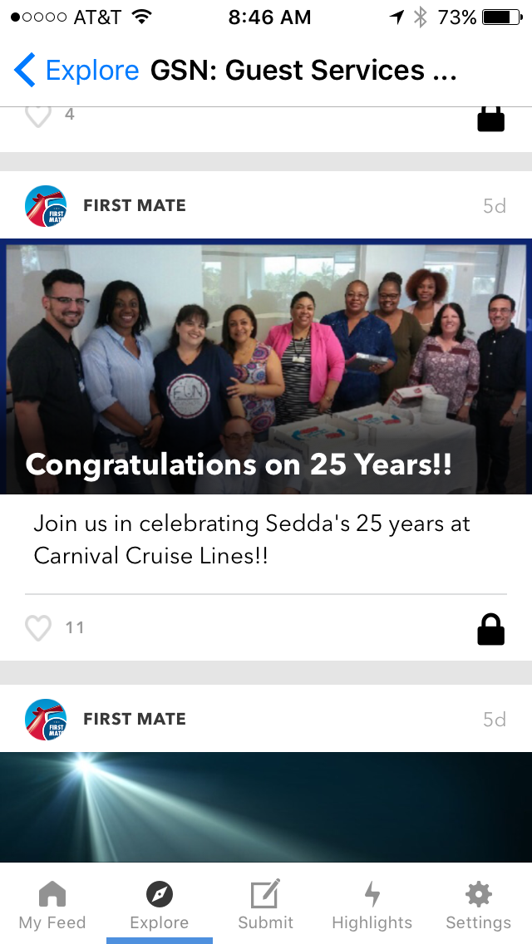
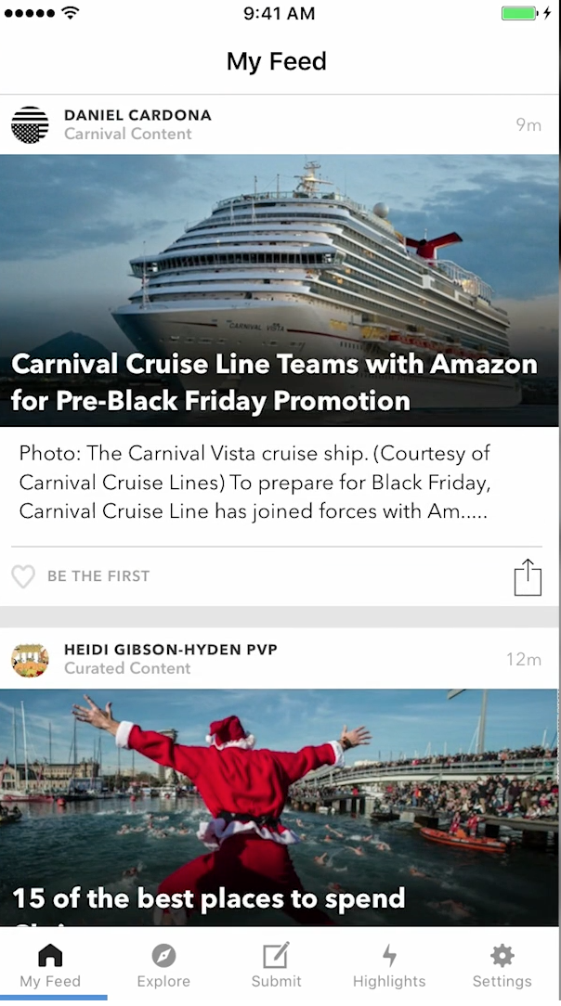
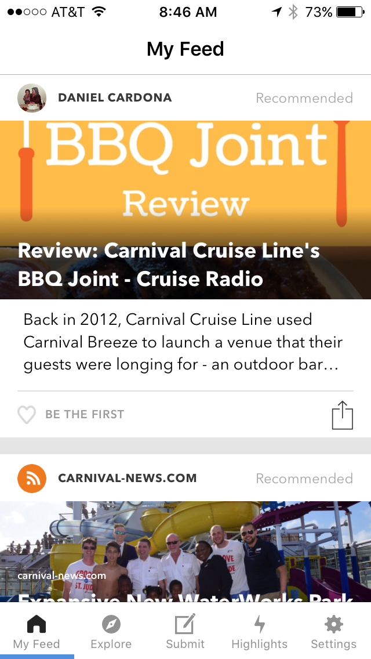
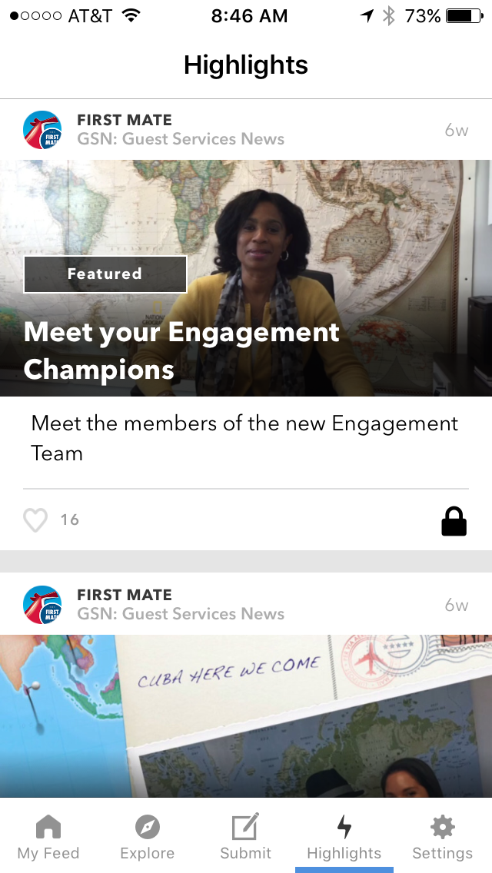
First Mate

Slide 10
Myth #1
Employee Advocacy Drives Leads

Slide 11
False: Employee Advocacy Stimulates Conversation to Generate Interest
Employee advocacy objectives
Energize existing personal social networks for employees, retain customers and keep employees engaged regarding all aspects of the industry.
Employee advocacy is not about driving sales or generating leads
Customer advocacy objectives
Shape brand perception
Lead generation
Key considerations
SocialChorus allows for consistency with branding, quantifiability and efficiency, regarding engagement and sharing
11

Slide 12
Myth #2
Employee Networks are the Most Powerful

Slide 13
False: It’s the Extended Network
Wrong Methodology
Right Methodology
Customer’s Network
Employee’s Network
Employee
Customer’s Network
At an average of 300 friends, every network is 100 impressions
Customer’s Network
13
Notes:
match with branding

Slide 14
Myth #3
You can mandate employee engagement and advocacy

Slide 15
False: It Needs to be Nurtured
How do we change the current mindset regarding employee engagement?
Start from scratch
Small sessions
How do we address resistance to embracing an engagement program?
Still optional
How do we integrate social selling into the daily process on all levels?
First 10 minutes of the day
10 minutes after lunch
15

Slide 16
Myth #4
Great Content Drives Engagement

Slide 17
False: Engagement Creates Engagement
In the past we have focused on PVPs driving engagement without reciprocating
Over 60% of the time spent on social selling will be in regard to engaging with their respective network
This includes:
Responding (like, comment)
Sharing
Providing content will be a secondary function
We should see increased engagement due to reciprocity
“You can make more friends in two months by becoming interested in other people than you can in two years by trying to get other people interested in you.” -Dale Carnegie
17
Notes:
not a one way street, need to care

Slide 18
Myth #5
Employees Don’t Want Notifications from their Company

Slide 19
False: Employees Want Relevant and Timely Notifications
Notification campaigns
Serves as reminders to push the content that increases engagement
Emails and mobile
Tone

Slide 20
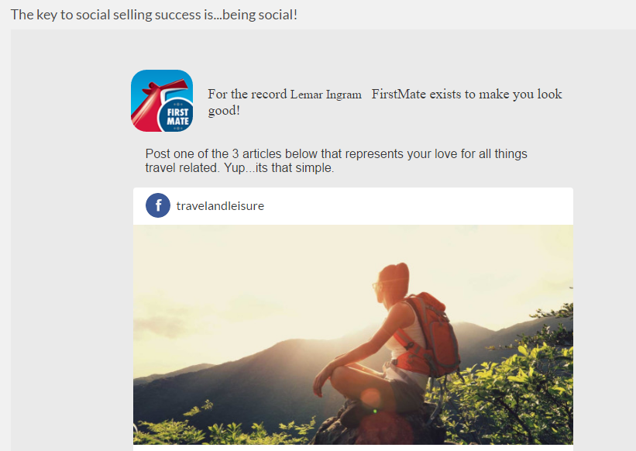
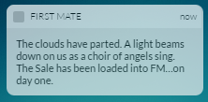
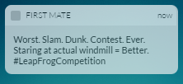
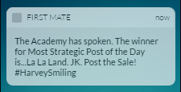

Slide 21
Myth #6
Communicators don’t have access to metrics

Slide 22
False: Real Time Data Enables Program Optimization
First Mate Metrics:
58% of joined users are active
90% Monthly Retention Rate vs 55% other programs
Customer participation and effectiveness:
Engagements:
2017: 27K Engagements
2016: 143K Engagements
Key considerations:
Empowering innovations yield financial results slower than efficiency innovations
-Clara Shih The Social Business Imperative
22
Notes:
69 sharers per sharer
41, 100 total shares
earned media value 1.1M 14 x ROI
Benchmarks

Slide 23
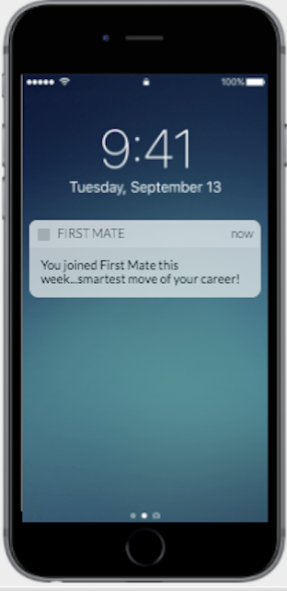
Final Thoughts
23
Notes:
Screen shot of first mate push notification

Slide 24
Have a Question?
Chat with us on ReadyTalk!

Slide 25
SocialChorus is the employee activation platform that personalizes your employees connection to work

Slide 26
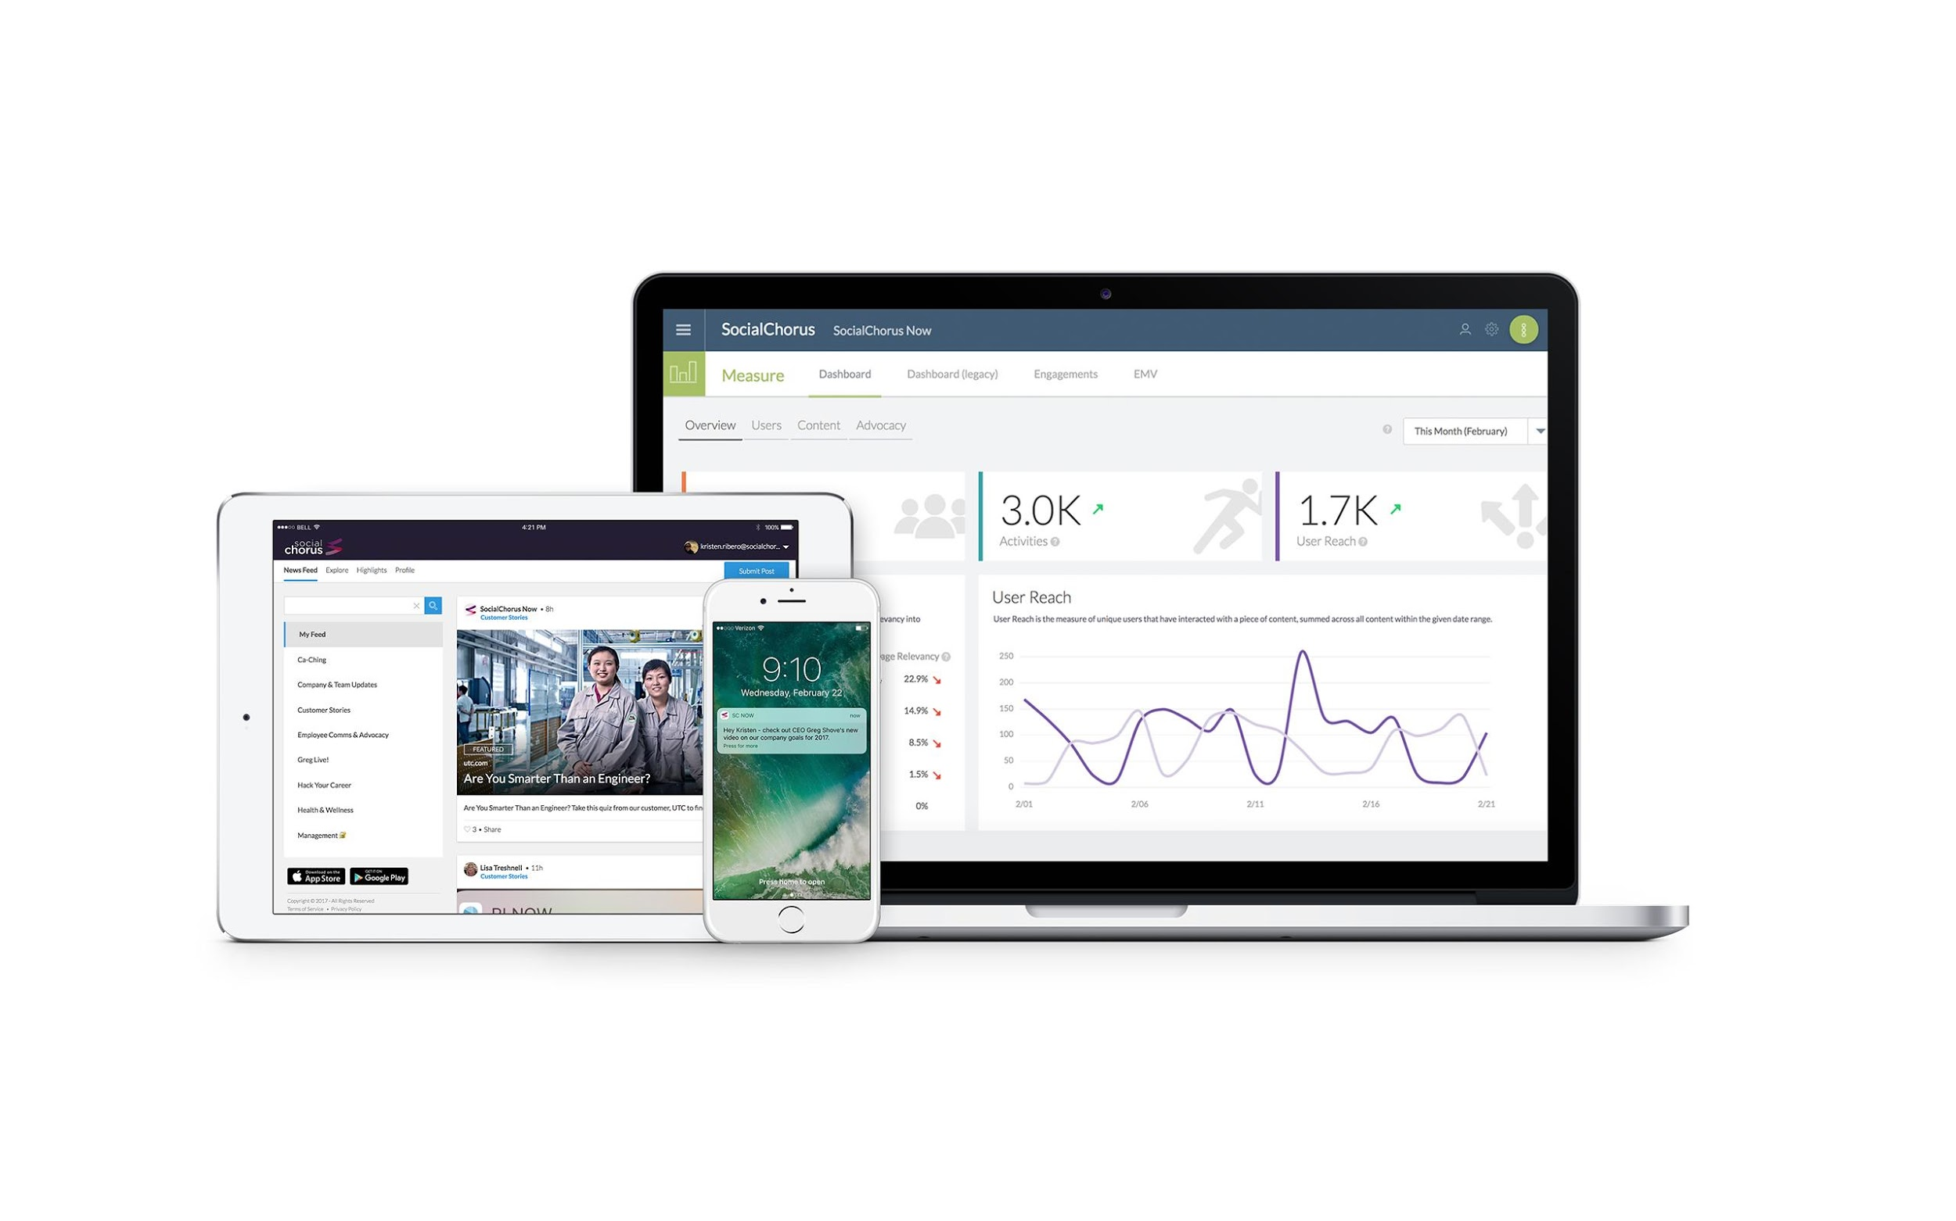

Slide 27
Provide all employees with a mobile front door to the enterprise

Slide 28
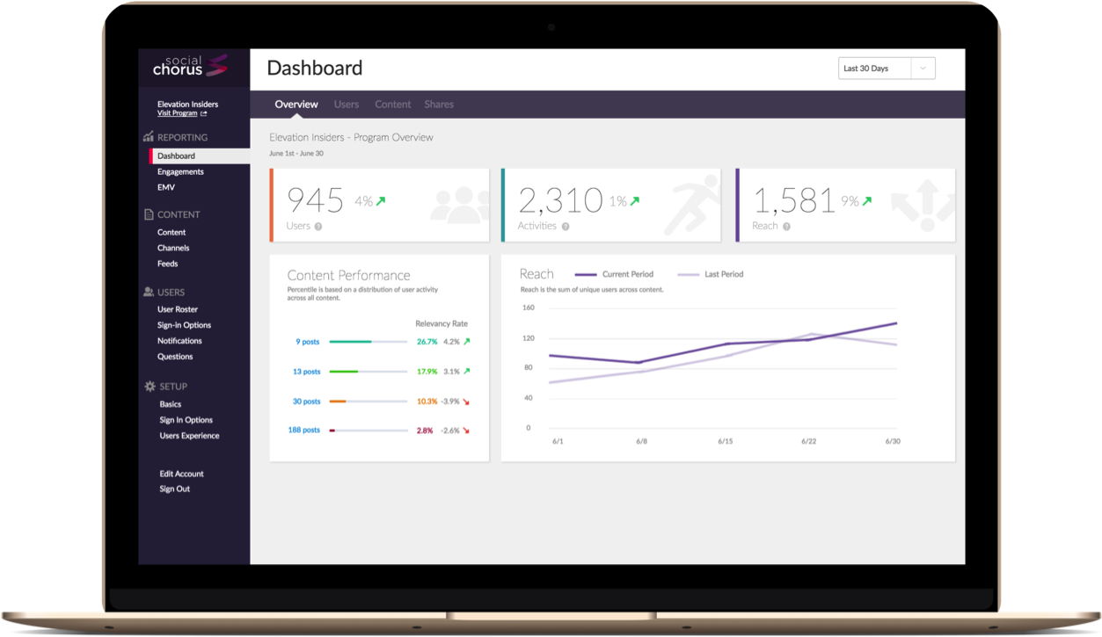
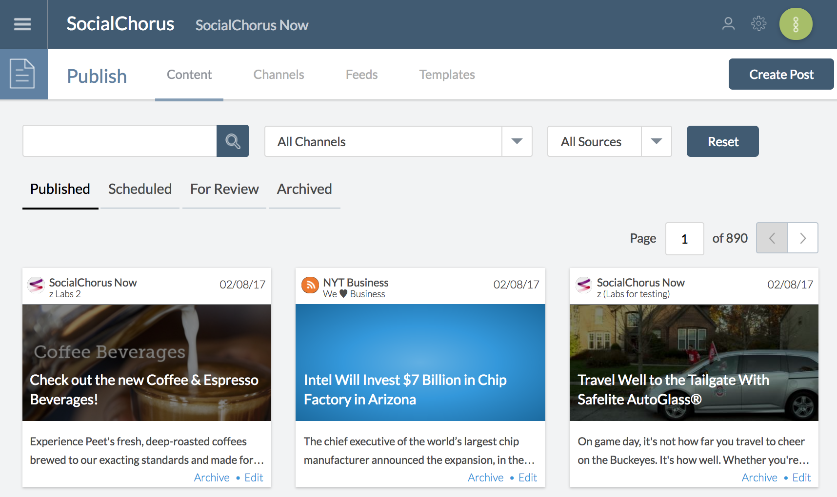
Accelerate results with powerful content targeting & automation

Slide 29
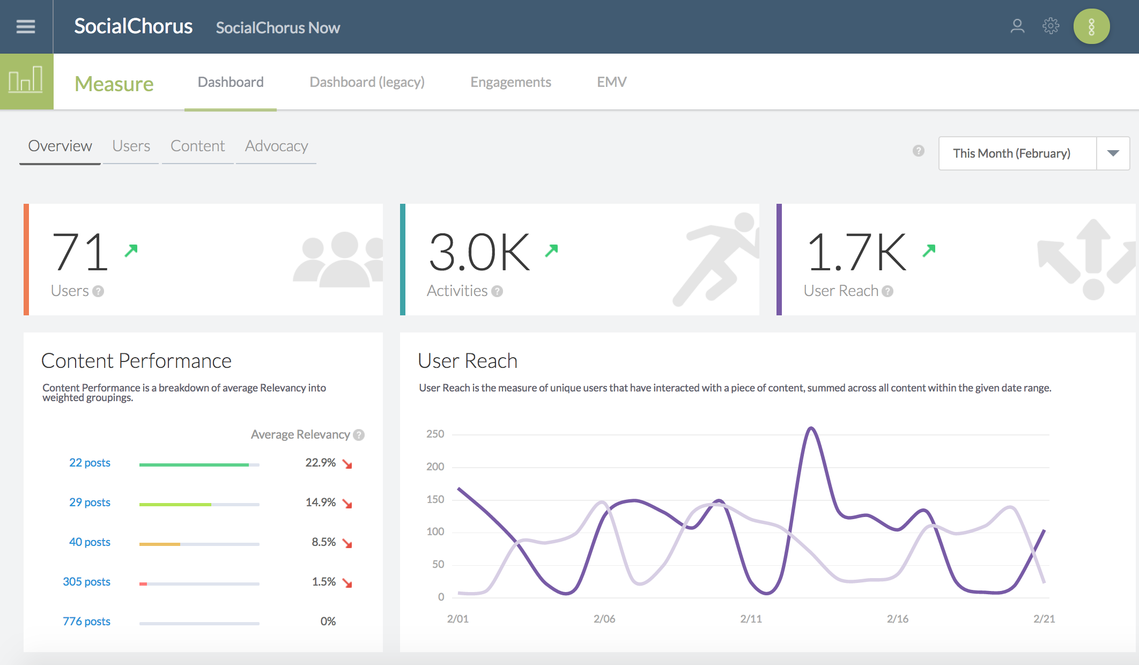
Optimize communications initiatives with data

Slide 30
Protect the business with enterprise-grade infrastructure & security

Slide 31
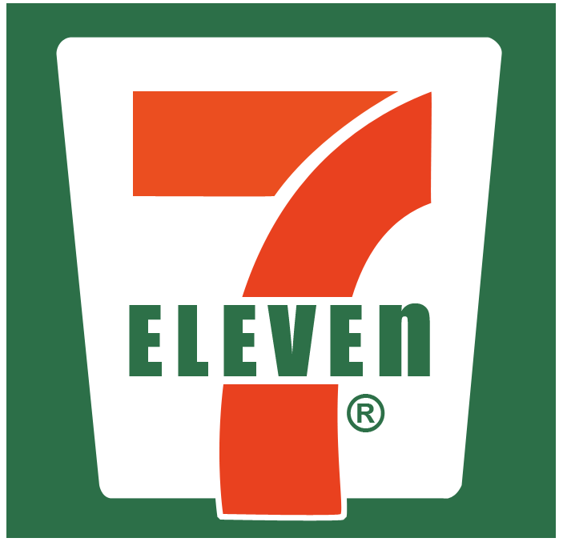
Notes:
swutch logos

Slide 32
Interested in learning more?
Request a Custom Demo
844.975.2533
http://www.socialchorus.com/tour
info@socialchorus.com

Slide 33
Sign up for our next webinar!
Building a Gateway: How Mobile is Transforming Employee Communications
April 20, 2017
11AM PT/ 2 PM ET
Register here!

Slide 34
Thank You!

